Slide 1
WiMax
WiBros

Slide 2
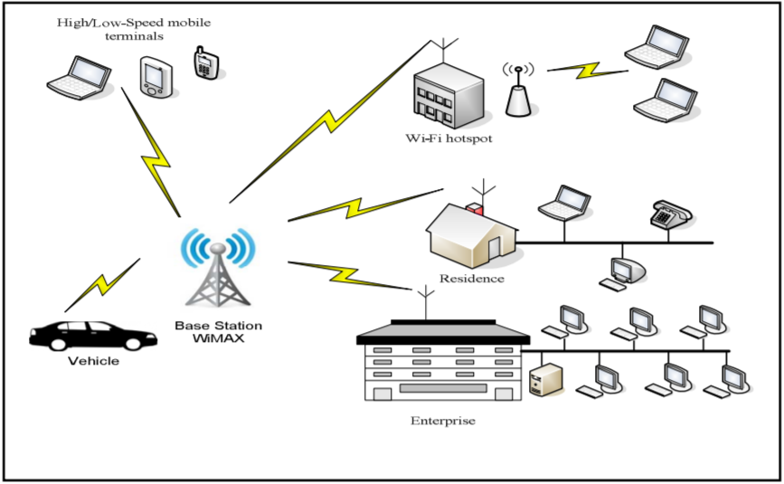
Physical Layer
WiMAX adheres to the IEEE 802.16 protocol, which defines wireless broadband technology which utilize physical and data link layer options.
The WiMAX physical layer operates in the 2-11 GHz range, which is defined in 802.16 as Non-Line-of-Sight (NLOS) wireless transmission.
Base Stations are connected to multi-point Subscriber Stations utilizing layer 2.

Slide 3
Physical Layer
Frequency Bands
2.5 GHz
3.5 GHz
5.7 GHz
The frequency bands typically used are to not interfere with 802.11 WiFi protocols (2.4 and 5 GHz).
Communicates using Orthogonal Frequency Division Multiplexing, single and multiple access versions (OFDM & OFDMA).
Channel bandwidths are scalable from 1.5 MHz to 20 MHz
Channel bandwidth and link throughput are directly proportional.

Slide 4
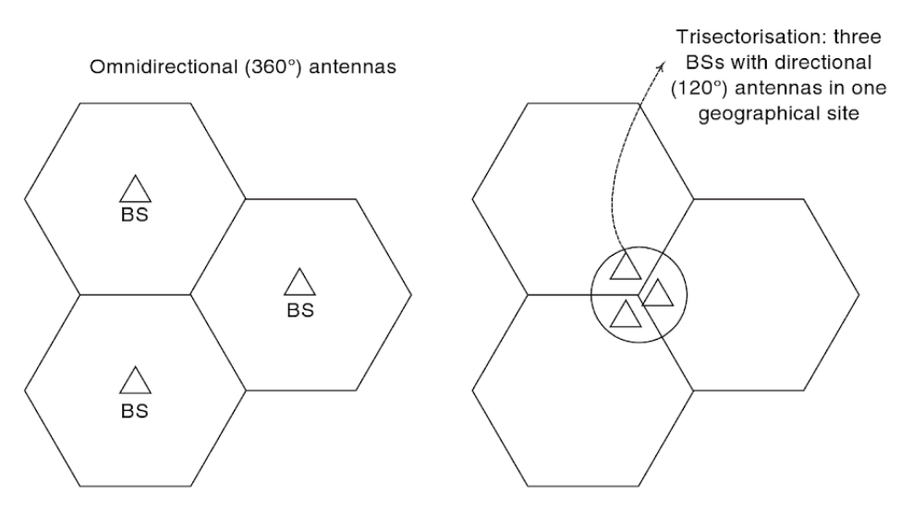
Physical Layer
WiMAX typically uses the cellular model in order to limit costs
Instead of omnidirectional antennae, utilizes trisectorization

Slide 5
Data Link Layer
The logical topology includes the Medium Access Control Layer (MAC) and Logical Link Control (LLC)
The MAC layer is separated into three different sublayers
Convergence Sublayer
Provides transformation or mapping of external network data
Converted into MAC service data units (SDUs) for the common part sublayer
Quality of Service (QoS) management
Common Part Sublayer
Bandwidth allocation
Connection establishment and maintenance
Security Sublayer
Authentication
Secure key exchange
Encryption and integrity control access

Slide 6
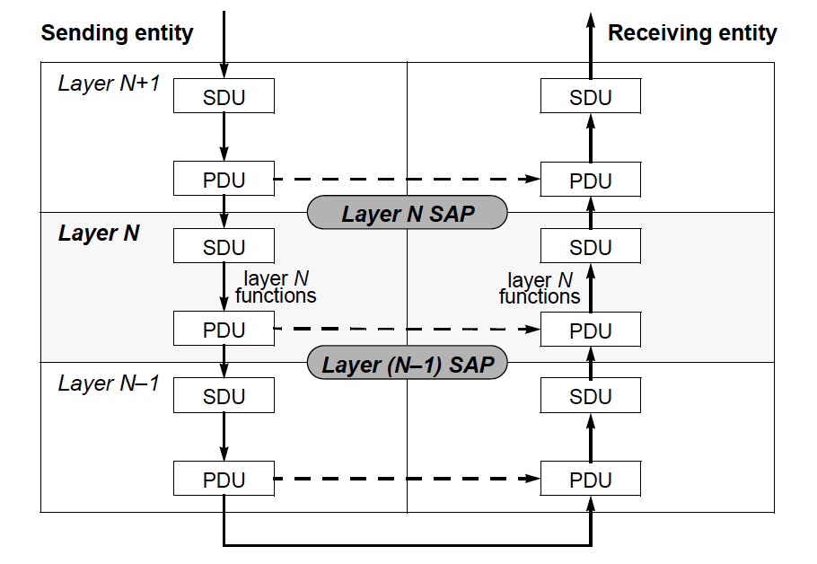
Data Link Layer
Protocol Data Unit and Service Data Unit interaction between entities
MAC PDUs are sent by one entity and received as Physical SDUs by the other entity
WiMAX has mechanisms for requesting bandwidth, QoS and traffic parameters, along with transporting all routing data and parameters to each appropriate sublayer

Slide 7
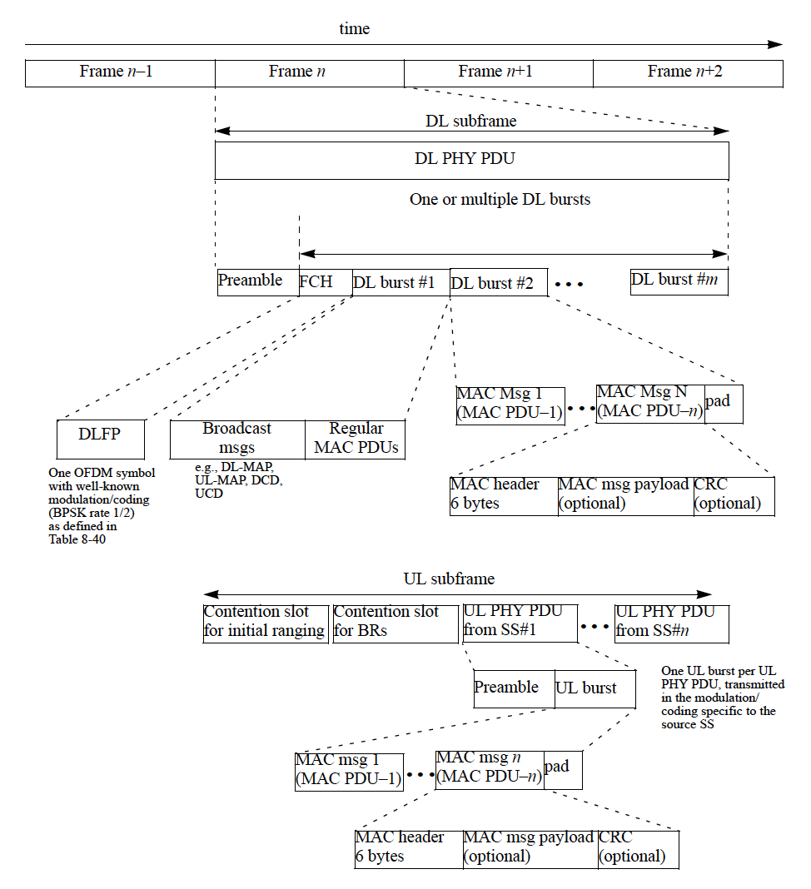
Data Link Layer
Typical OFDM frame
Consists of a downlink subframe and uplink subframe which both contain MAC PDUs and physical layer information
MAC headers with layer 2 and ARQ information
Downlink subframe with a preamble for synchronization
Uplink subframe for SS bandwidth and range data and other optional messages

Slide 8
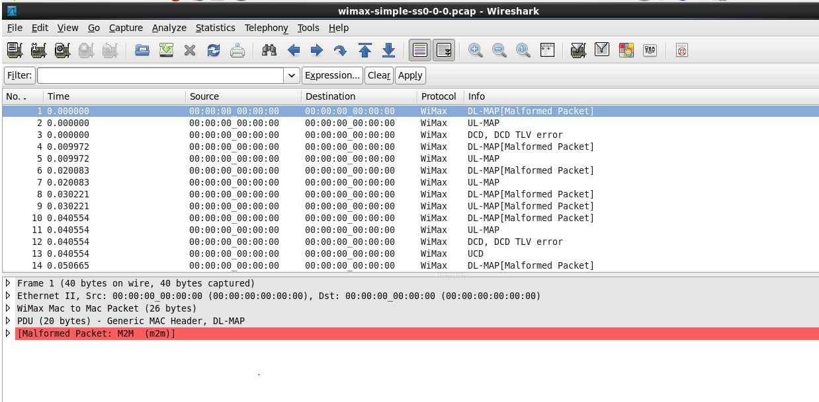
Example Wireshark Capture

Slide 9
WiFi Compared To WiMAX
WiFi is a direct competitor to WiMAX. WiFi is more widely adopted in developed nations, where last-mile coverage is not as necessary or hard to achieve as less developed and more rural countries [3].
In 2011, the WiMAX Forum estimated that WiMAX service reached almost one billion people, but hopes of reaching the US market have been centered on the wireless carrier Sprint’s adoption of the service[7].
As of 2011, WiMAX was available in 71 markets around the US and is based on the 802.16e mobileWiMAX standard[7].

Slide 10
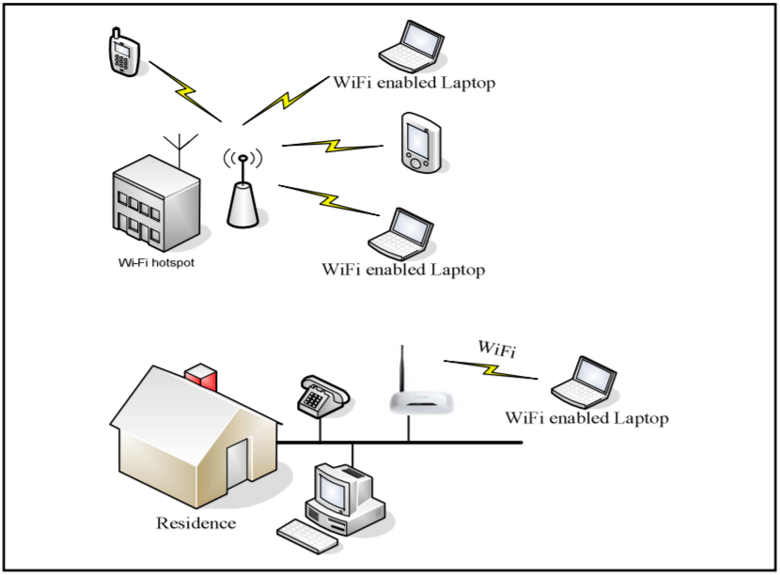
Infrastructure Comparison
WiFi
WiMAX

Slide 11
Successes
MIMO Technology where there are multiple antennas at the base station & at the wireless device. MIMO improves reception and rate of transmission.
Space-Time Frequency Coding – A method of encoding data at the transmitter and decoding data at the receiver.
Beam Formatting - better signal in low data rate areas. Array of antennas creates signals that interfere spatially to provide a stronger signal at edge of range
Downlink Channel Reporting - In a noisy area, data will be sent at a lower rate but with a clear connection higher data rates are used.
146 countries used WiMax (in 2009)
Easier to setup than LTE
WiMAX is popular due to its low cost and flexible nature.
It can be installed faster than other internet technologies because it can use shorter towers and less cabling, supporting even non-line-of-sight (NLoS) coverage across an entire city or country.

Slide 12
Failure
Wimax lost to LTE
LTE was cheaper to install because of existing networks.
A reason for WiMax’s failure is compatibility. Although LTE arrived much later than WiMax, it was actually just an upgrade to existing networks.

Slide 13
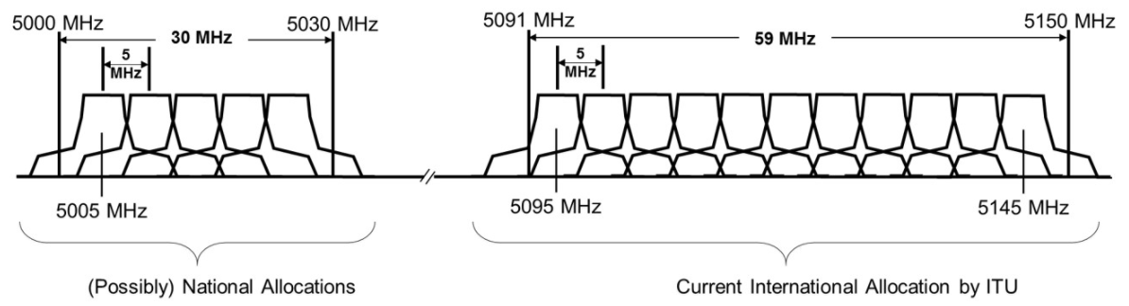
AeroMACS operates in a different frequency than 4G and LTE
4G operates in the following frequencies: 700 MHz, 1700-2100 MHz, 1900MHz and 2500-2700 MHz
WiMAX operates in the following frequencies: 2.5 GHz, 3.5 GHz 5.7 GHz
AeroMACS operates in following frequency range:
5091MHz – 5150MHz

Slide 14
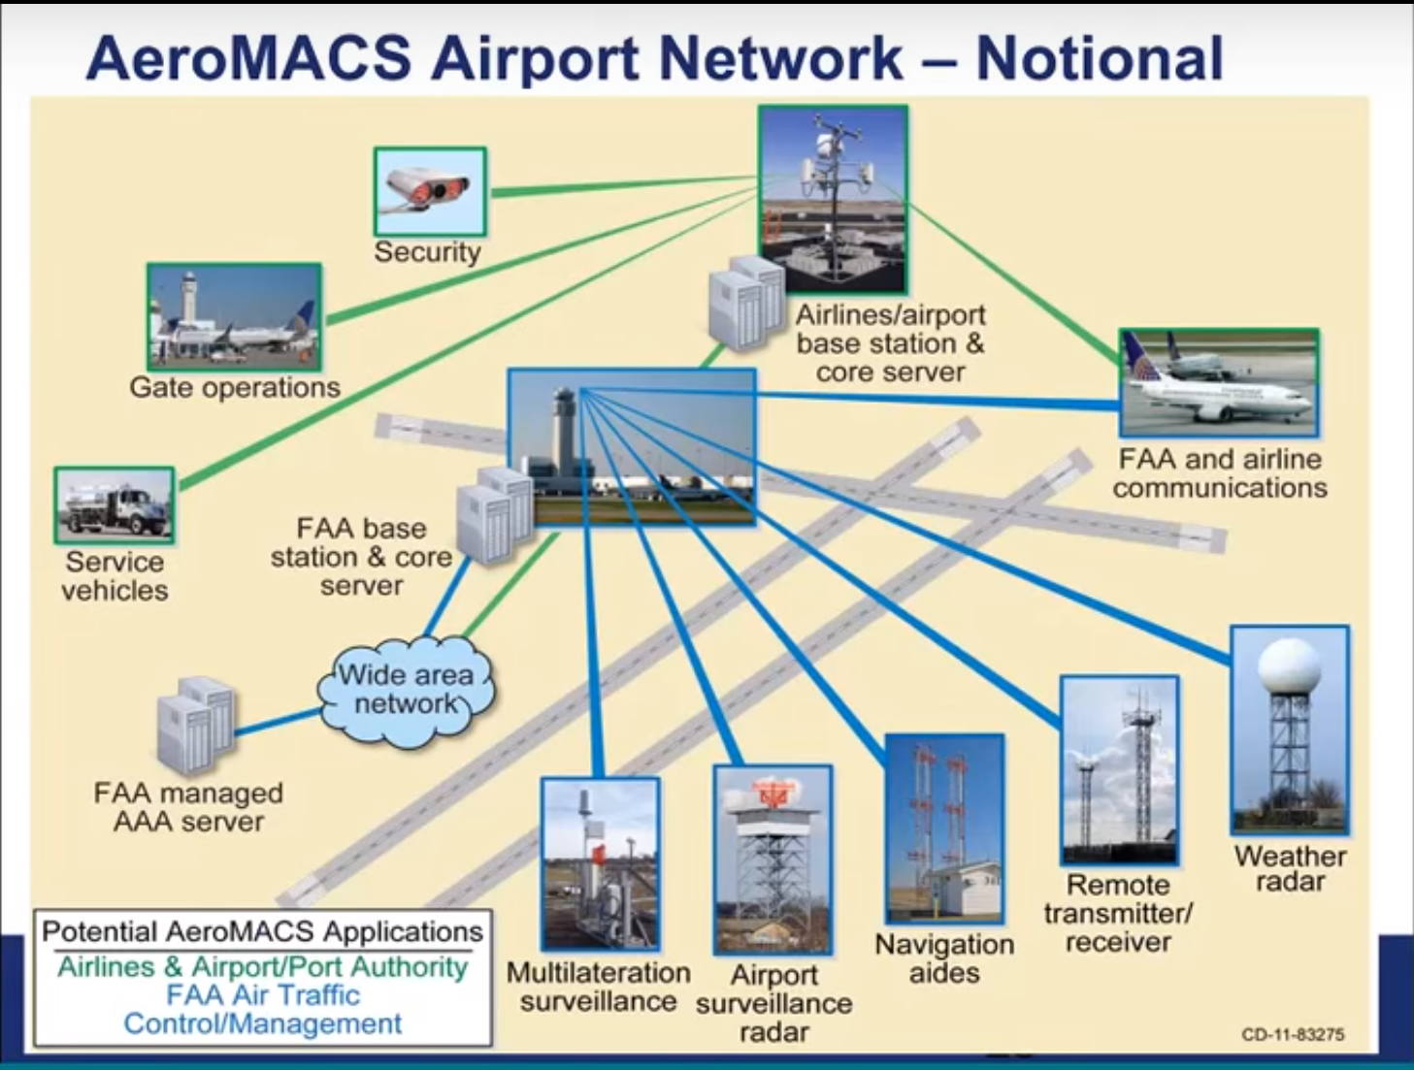

Slide 15
